Slide 1
Convolutional Neural Networks
1378 Spr. 2024 Module 06

Slide 2
Today’s Agenda
Introduction to Convolutional Neural Networks
Core components of CNNs and how they process images
CNN training and leveraging libraries
Applications, challenges, and future research
Computer Vision datasets

Slide 3
Last Class Recap
How NN works
Forward Propagation
Cost Functions
Activation and Output Functions
Optimizers
Backpropagation

Slide 4
Basic NN for Image Classification

Slide 5
Image Classification with MLP
Too Many Parameters
Notes:
you will see the model summary printed as shown in figure 3.4. You can see that the output of the flatten layer is a vector with 784 nodes, as discussed before, since we have 784 pixels in each 28 × 28 images. As designed, the hidden layers produce 512 nodes each; and, finally, the output layer (dense_3) produces a layer with 10 nodes
The Param # field represents the number of parameters (weights) produced at each layer. These are the weights that will be adjusted and learned during the training process.
They are calculated as follows:.
1 Params after the flatten layer = 0, because this layer only flattens the image to a vector for feeding into the input layer. The weights haven’t been added yet.
2 Params after layer 1 = (784 nodes in input layer) × (512 in hidden layer 1) + (512 connections to biases) = 401,920.
3 Params after layer 2 = (512 nodes in hidden layer 1) × (512 in hidden layer 2) + (512 connections to biases) = 262,656.
4 Params after layer 3= (512 nodes in hidden layer 2) × (10 in output layer) + (10 connections to biases) = 5,130.
5 Total params in the network = 401,920 + 262,656 + 5,130 = 669,706.
This means that in this tiny network, we have a total of 669,706 parameters (weights and biases) that the network needs to learn and whose values it needs to tune to optimize the error function. This is a huge number for such a small network. You can see how this
number would grow out of control if we added more nodes and layers or used bigger images. This is one of the two major drawbacks of MLPs that we will discuss next.

Slide 6
Limitations of MLPs (Basic NN)
MLPs face challenges in image processing due to their inability to preserve spatial relationships in images, leading to a loss of critical feature information. Moreover, MLPs require a vast number of parameters, making the model inefficient and prone to overfitting when dealing with high-dimensional image data.
Notes:
Let's explore why traditional neural networks (MLPs) aren't always ideal for image classification. MLPs excel with data where order doesn't matter. Think of a customer database – swapping two customers' information would likely have little impact. Images are different; the position of pixels is crucial to understanding the content. MLPs require images to be flattened, disrupting this structure.
The MNIST dataset, with its handwritten digits, shows MLPs can handle images, but at a cost. The sheer amount of image data leads to a massive number of parameters, making MLPs prone to overfitting and slow to train.
This is where CNNs shine. They have specialized layers that analyze the image directly, keeping spatial relationships intact. Convolutional layers find patterns regardless of location, while pooling layers make everything faster without sacrificing essential information. CNNs even use familiar fully connected layers for final classification, but with the benefit of working with the powerful image features extracted beforehand.
the application of Multi-Layer Perceptrons (MLPs) to image classification problems, focusing on the MNIST dataset as a case study.
MLP Architecture Overview: It starts by recalling the MLP architecture from a previous chapter, highlighting its structure of an input layer, one or more hidden layers, and an output layer. This architecture is used to classify images of digits (0 to 9) within the MNIST dataset.
Input Layer Processing: The document explains the preprocessing required for 2D images to be used with MLPs, emphasizing the need to flatten the image into a 1D vector. This process, although necessary, leads to a loss of spatial information which is critical for understanding images.
Hidden Layers and Activation Functions: The MLP architecture for the MNIST dataset typically includes two hidden layers with a ReLU (Rectified Linear Unit) activation function. This section outlines the role of hidden layers in learning features from the input data and the importance of choosing the right activation function for these layers.
Output Layer Configuration: The output layer's design is straightforward, with the number of nodes equal to the number of classes to be detected. In the MNIST example, this means 10 nodes. The softmax activation function is recommended for the output layer in multi-class classification problems.
Putting It All Together: A detailed example shows how to construct the MLP model using Keras, a popular deep learning library. This includes flattening the image for the input layer, adding densely connected layers for the hidden layers, and configuring the output layer with the softmax function.
Drawbacks of Using MLPs for Image Classification: The section concludes by discussing the limitations of using MLPs for image classification, notably the significant loss of spatial features due to flattening the image and the high computational cost associated with fully connected layers. It hints at Convolutional Neural Networks (CNNs) as a more efficient alternative for handling image data, setting the stage for the next sections of the chapter.

Slide 7

Convolutional Neural Networks

Slide 8

Introduction To CNNs
Convolutional Neural Networks (CNNs) mark a significant advancement in image processing, offering unparalleled accuracy in tasks like image classification. Unlike traditional Multi-Layer Perceptrons (MLPs) that struggle with spatial data, CNNs excel by maintaining the spatial hierarchy of features, making them ideal for computer vision applications.

Slide 9
Convolutional Neural Networks
High level CNN architecture
Input layer
Convolutional layers for feature extraction
Fully connected layers for classification
Output prediction
Notes:
Overview of Image Classification Pipeline: We have starts by revisited the image classification pipeline introduced earlier . It outlines the four critical steps involved in the process: Input Data, Preprocessing, Feature Extraction, and the Machine Learning (ML) Model. These steps are essential for transforming raw image data into a format that can be analyzed and classified by a model.
Transition from Traditional ML to Deep Learning: Before the advent of deep learning, feature extraction was predominantly a manual process, where features were handpicked and then fed into a classifier like SVM (Support Vector Machines). neural networks revolutionize this process , which automate feature learning and classification, thus streamlining steps 3 and 4 of the image classification pipeline.
CNN Architecture Simplification: CNN architecture has three main components: the Input Layer, Convolutional Layers (for feature extraction), and Fully Connected Layers (for classification). This simplification serves to illustrate CNN's high-level structure, emphasizing its efficiency in handling images by retaining spatial hierarchies and reducing parameter count through localized connections.
Illustrative Example: the hypothetical example above is provided to visualize how CNNs process an image to classify it into one of two categories. This example walks through the journey of an image through convolutional layers where feature maps are created and progressively abstracted, highlighting the network's ability to learn complex features through depth.
Feature Extraction and Classification in CNNs: Convolutional layers learn features from the image, transforming them into a compact representation. This representation is then used by fully connected layers to classify the image. This demonstrates the CNN's unique ability to both extract and use image features for classification. convolutional layers extract features from images, transforming them into a flattened vector of learned features. This vector then passes through fully connected layers, which classify the image based on these features. This process showcases the dual role of The section elaborates on how CNNs in both feature learning and classification, setting the stage for their detailed exploration in subsequent sections.
CNNs are often used to perform obj classification as they are well suited to handle image data and can capture complex patterns and relationships between pixels.
Ti improve performance of the model techniques such as data augmentation , transfer learning and regularization may be used

Slide 10
How CNNs Learn Patterns
Notes:
How CNNs learn patterns
It is important to note that a CNN doesn’t go from the image input to the features vector directly in one layer. This usually happens in tens or hundreds of layers, as you will see later in this chapter. The feature-learning process happens step by step after
each hidden layer. So the first layer usually learns very basic features like lines and edges, and the second assembles those lines into recognizable shapes, corners, and circles. Then, in the deeper layers, the network learns more complex shapes
such as human hands, eyes, ears, and so on. For example, here is a simplified version of how CNNs learn faces.
A simplified version of how CNNs learn faces
You can see that the early layers detect patterns in the image to learn low-level features like edges, and the later layers detect patterns within patterns to learn more complex features like parts of the face, then patterns within patterns within patterns,
and so on:
Input image
+ Layer 1 ⇒ patterns
+ Layer 2 ⇒ patterns within patterns
+ Layer 3 ⇒ patterns within patterns within patterns
... and so on
This concept will come in handy when we discuss more advanced CNN architectures in later chapters. For now, know that in neural networks, we stack hidden layers to learn patterns from each other until we have an array of meaningful features to identify
the image.

Slide 11
CNN 3 Core Components
(Output)
Convolutional Neural Network (CNN) is usually made of the following layers:
Convolutional layers,
Pooling layers,
Fully Connected layers (Dense)
(Input)
Notes:
CNNs consist of three core components: Convolutional layers, Pooling layers, and Fully Connected layers. This structure enables efficient feature extraction and classification by sequentially filtering, reducing, and interpreting image data, significantly improving performance and accuracy in image-related tasks.

Slide 12
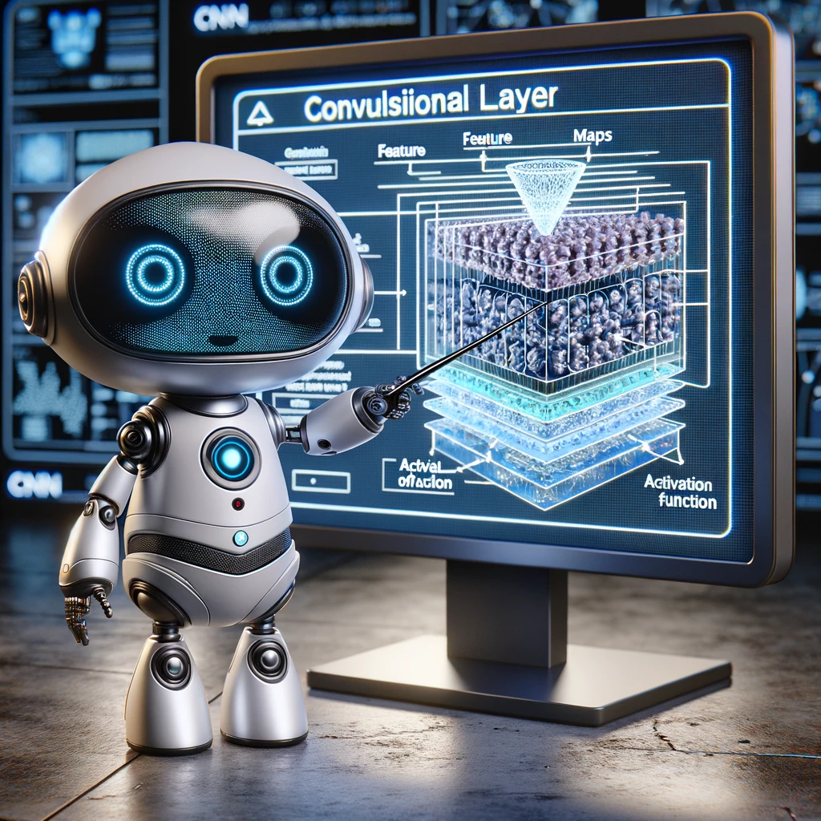
Convolutional Layer

Slide 13

Convolutional Layer
The Core Function: Acts as the main feature extractor within a CNN.
How it Works:
Employs sliding filters (kernels) to detect image patterns.
Detects edges, textures, and increasingly complex features as the network deepens.
Output: Produces feature maps that highlight where specific features exist within the image.
Notes:
The convolutional layer acts as the core feature extractor in CNNs. It employs filters (or kernels) that slide over the input image to detect patterns such as edges, textures, or more complex features depending on the depth of the network. This layer's output is a set of feature maps that represent different aspects of the input image, highlighting where certain features are detected.

Slide 14

2D Convolution Example
(vdumoulin@ Github)
The kernel slides over the original image pixel by pixel and calculates the convolved
image on the next layer. The convolved area is called the receptive field.
Notes:
Convolutional Filter is called a Kernel
The kernel size refers to the dimensions of the convolution filter
Remember that filters contain the weights that will be learned by the network. So, theoretically, the bigger the kernel_size, the deeper the network, which means the better it learns. However, this comes with higher computational complexity and might lead to overfitting.
Kernel filters are almost always square and range from the smallest at 2 × 2 to the largest at 5 × 5. Theoretically, you can use bigger filters, but this is not preferred because it results in losing important image details.

Slide 15
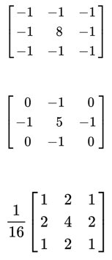
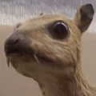
Filters
What will happen after the filters?
(wikipedia)

Slide 16
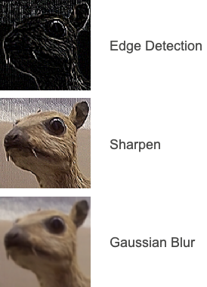
Filters
(wikipedia)

Slide 17

Pooling Layer

Slide 18
Pooling
Pooling layers reduce the spatial size of the feature maps, decreasing the number of parameters and computations in the network. This downsampling process helps in making the detection of features more robust to scale and orientation changes.
Pooling is used to reduce size (h & w) of the feature map.
can operate with padding and stride
no weights to train
Max Pooling: Returns the maximal value in the pooling window
Average Pooling: Returns the average in the window
Notes:
Key benefits of Pooling
Dimensionality Reduction: Pooling significantly reduces the number of parameters and computation, speeding up the training process and reducing the risk of overfitting.
Feature Preservation: Despite the reduction in size, essential features for classification are preserved, enabling efficient learning.
Translation Invariance: By abstracting over small translations, pooling layers ensure that the network's performance is robust to variations in the position of features within the image.
About Pooling
Pooling an operation that uses a specific window size (often referred to as the "pooling size") to perform downsampling over the feature maps produced by the convolutional layers in a Convolutional Neural Network (CNN). The concept of "size" in the context of pooling refers to this window or region over which the pooling operation (such as max or average pooling) is applied, not the filter size used in convolutional layers.
Here's a breakdown to clarify:
Convolutional Layer Filters: In convolutional layers, filters (or kernels) of a certain size (e.g., 3x3, 5x5 pixels) slide over the input image to extract features. The size of these filters determines the extent of the area in the input image that each convolution operation considers at a time.
Pooling Operation: After convolutional layers have applied filters to the input image and generated feature maps, pooling layers then apply a downsampling operation over these feature maps. The "pooling size" (e.g., 2x2, 3x3) specifies the region over which the pooling operation is applied. For example, a 2x2 max pooling operation looks at each 2x2 area in the feature map and keeps only the maximum value, reducing the spatial dimensions of the feature maps.
Function of Pooling: The primary function of pooling is to reduce the spatial dimensions (width and height) of the feature maps, thus reducing the number of parameters and computation in the network. This operation helps to make the detection of features somewhat invariant to scale and translation, improving the network's robustness.
In summary, while both convolutional filters and pooling operations involve the concept of size, they serve different purposes and operate at different stages within the CNN architecture. The filter size in convolutional layers affects the feature extraction process, while the pooling size in pooling layers affects the downsampling process.
Differences between kernel size in convolutional layers and pooling size in pooling layers within Convolutional Neural Networks (CNNs) to resolve the confusion:
Kernel Size in Convolutional Layers
Definition: The kernel (or filter) size in convolutional layers refers to the dimensions of the filter matrix that slides over the input image (or the previous layer's output) to perform the convolution operation.
Purpose: The purpose of the convolution operation is to extract features from the input image. The kernel systematically applies a dot product between the kernel and local regions of the input, producing a feature map that highlights where specific features are detected in the input.
Example Sizes: Common kernel sizes include 3x3, 5x5, and 7x7. A 3x3 kernel means the filter covers a 3-pixel by 3-pixel area of the input image.
Pooling Size in Pooling Layers
Definition: Pooling size refers to the dimensions of the window that is used to perform the pooling operation over the feature maps generated by convolutional layers. This operation reduces the spatial dimensions (i.e., width and height) of the feature maps.
Purpose: The main goals of pooling are to reduce the amount of information and computation required for the subsequent layers, to make the detection of features invariant to small changes and translations, and to control overfitting by providing an abstracted form of the feature maps.
Example Sizes: Common pooling sizes include 2x2 and 3x3. A 2x2 pooling size means that the pooling operation considers a 2-pixel by 2-pixel area of the feature map at a time. During this operation, it typically takes the maximum (max pooling) or average (average pooling) of the values within this window.
Key Differences
Operation: The kernel size in convolutional layers is related to the extraction of features by applying filters to the input or feature maps, whereas the pooling size in pooling layers is related to the downsampling or reduction of the spatial dimensions of the feature maps.
Outcome: The outcome of applying a kernel in a convolutional layer is a new set of feature maps that emphasize certain features in the input. The outcome of applying pooling is a reduced version of the input feature maps, making the network less sensitive to the exact location of features.
In summary, the kernel size in convolutional layers determines how features are extracted from the input, while the pooling size in pooling layers determines how the feature maps are downsampled to reduce dimensionality and computation in the network.

Slide 19
Parameters Influencing Convolutional Layers
Filter Size: Determines how much of the input image is considered at once by each filter. Common sizes include 3x3 and 5x5.
Stride: Dictates the step size the filter takes as it slides over the image. A larger stride reduces the spatial dimensions of the output feature map.
Padding: Used to maintain the spatial dimensions of the output close to the input dimensions, allowing edges and corners to be effectively processed.
Activation Function: Typically, ReLU (Rectified Linear Unit) is applied to introduce non-linearity, allowing the network to learn complex patterns.
Other activation functions like sigmoid or tanh are used in specific contexts, such as the output layer for binary classification problems.

Slide 20
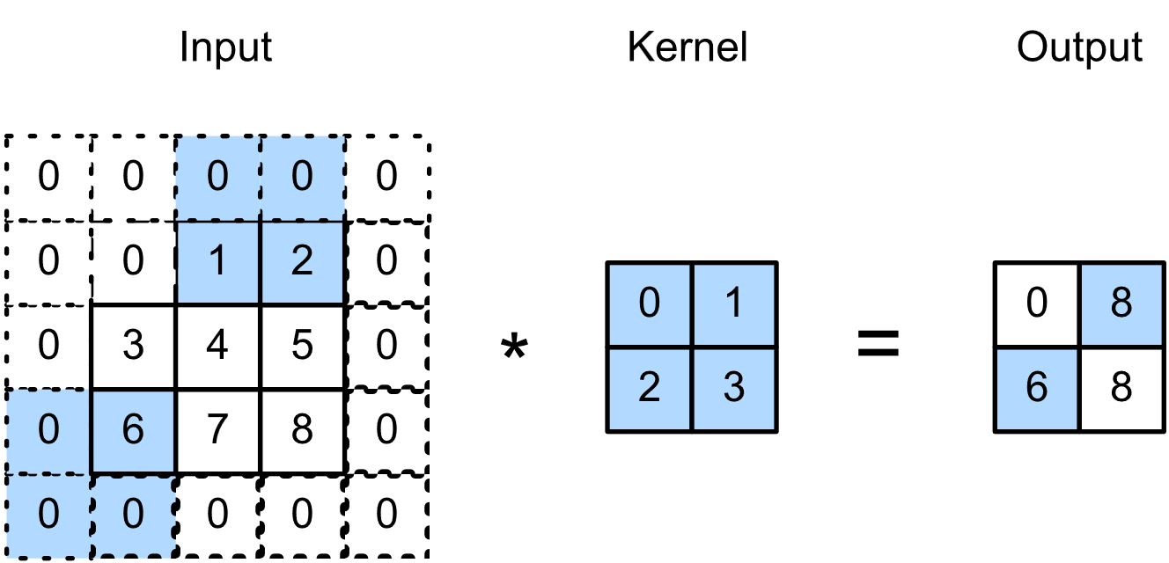
Stride
Stride is the number of pixels a filter (convolutional layer) or pooling window (pooling layer) shifts across an image.
How it Works:
Stride of 1: Thorough analysis, filter/window moves one pixel at a time.
Larger stride (e.g., 2): Skips pixels for faster processing, results in smaller output.
Output Impact: Stride directly influences the size of the output feature map - larger stride leads to a smaller output.
Notes:
Definition: Stride refers to the number of pixels by which the filter (in convolutional layers) or pooling window (in pooling layers) moves across the input image or feature map. It dictates the extent of overlap between the regions processed by successive operations of the filter or pooling window.
Functionality: A stride of 1 means the filter moves one pixel at a time, closely analyzing the input, whereas a larger stride, such as 2, means the filter skips pixels, covering a broader area more quickly and producing a smaller output size.
Impact on Output Size: The stride affects the size of the output feature map. A larger stride results in a smaller output dimension, as the filter or pooling window covers the input in fewer steps.

Slide 21

Padding
Definition:
Adding pixel borders around an image before convolution or pooling.
Purpose:
Control output feature map size
Prevent losing information at image edges
Types:
Valid: No padding, output shrinks.
Same: Maintains output size with stride 1.
Notes:
Definition: Padding involves adding a border of pixels around the input image or feature map before applying the convolution or pooling operation. This border can be filled with zeros (zero padding) or other values based on specific padding strategies.
Purpose: The primary purpose of padding is to control the spatial size of the output feature maps. Without padding, the size of the feature maps would shrink significantly with each convolutional layer, potentially losing important information at the borders. Padding allows the network to maintain the spatial dimensions of the output closer to those of the input.
Types of Padding:
Valid Padding: No padding is applied. The convolution or pooling operation is only applied to the valid positions within the input, leading to a reduction in output size.
Same Padding: Sufficient padding is applied to ensure that the output feature map has the same spatial dimensions as the input when the stride is 1.

Slide 22
Stride and Padding Combined Role
Determine how the filter/window moves across the image and how output size is controlled.
Key Idea: Stride and padding allow you to balance:
Detailed features (smaller stride) vs. broader features (larger stride)
Maintaining desired output size
Importance: Crucial for designing effective CNNs that learn spatial patterns efficiently.

Slide 23
Fully Connected Layers
Position: Fully Connected (FC) layers usually come after convolutional and pooling layers in a CNN.
Function: Perform high-level analysis on features extracted by earlier layers.
Input: Take a flattened vector of values from the previous layer.
Output: Generate a classification decision (often using a softmax activation for probability distribution).
Notes:
Fully Connected (FC) layers, often positioned after convolutional and pooling layers, are where all neurons in one layer are connected to all neurons in the next layer.
The primary function of FC layers is to perform high-level reasoning based on the features extracted and abstracted by previous layers.
Before entering an FC layer, the output from the preceding pooling or convolutional layers is flattened into a single vector of values.
FC layers culminate in a classification decision, with the final layer typically employing a softmax activation function to predict the probability distribution across target classes.

Slide 24
Training CNNs
CNN training aims to adjust filter and neuron weights to improve prediction accuracy
How it Works:
Backpropagation and gradient descent algorithms calculate and update weights to minimize errors.
Preventing Overfitting:
Regularization techniques (e.g., dropout, weight decay) help the model generalize better to new data.
Data Augmentation: Techniques like flipping, rotation, and scaling create more diverse training examples, making the model more robust.
Notes:
CNN training involves adjusting the weights of filters and neurons to minimize the difference between the predicted output and the true labels, typically using backpropagation and gradient descent algorithms.
Regularization techniques like dropout and weight decay are employed to prevent overfitting, ensuring the model generalizes well to unseen data.
Data augmentation methods, such as flipping, rotation, and scaling, are widely used to increase the diversity of training data, further improving the robustness of the model.

Slide 25

Leveraging Libraries for CNN Development
Modern deep learning libraries like TensorFlow and PyTorch provide high-level APIs to design, train, and deploy CNN models with ease, offering pre-built functions for convolutional layers, pooling layers, and optimization algorithms.
These libraries also offer extensive support for GPU acceleration, enabling the efficient processing of large datasets and complex models.

Slide 26

CNNs Applications
Beyond image classification, CNNs excel in various tasks including object detection, semantic segmentation, and face recognition, showcasing their versatility.
In healthcare, CNNs are used for medical image analysis, such as diagnosing diseases from X-rays and MRI scans.
In autonomous vehicles, CNNs interpret sensor data to identify obstacles, navigate roads, and understand traffic signals.

Slide 27
CNNs Challenges
3D Understanding: CNNs often struggle to fully grasp 3D structure from 2D images.
Domain Transfer: Applying CNNs trained on one dataset to significantly different data can be difficult.
Interpretability: Understanding how CNNs make decisions is crucial for trust and bias correction.
Notes:
Despite their success, CNNs face challenges like understanding the 3D structure from 2D images, transferring learning across different domains, and ensuring model interpretability.
Ongoing research is focused on developing more sophisticated architectures, improving training efficiency, and making CNNs more interpretable and fair.
The exploration of unsupervised and semi-supervised learning methods offers promising avenues for leveraging unlabeled data in training CNNs.

Slide 28

Future Research
Advanced Architectures: Designing new CNN structures for better performance and efficiency.
Training Improvements: Optimizing training methods for faster convergence and greater accuracy.
Interpretability & Fairness: Developing techniques to explain CNN decisions and reduce bias.
Unsupervised/Semi-supervised Learning: Unlocking the potential of unlabeled data for better CNN training.

Slide 29
Image Datasets

Slide 30
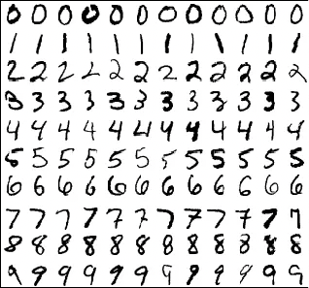
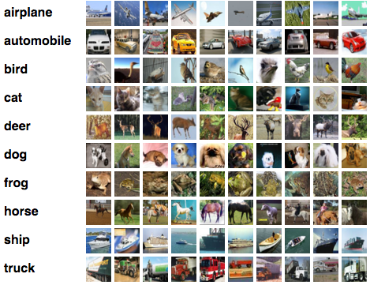
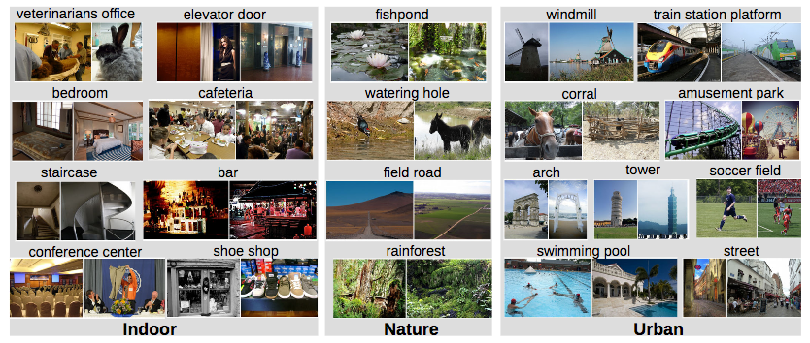
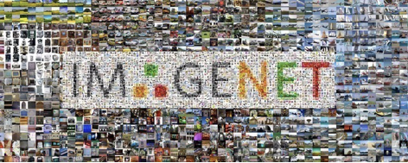
Computer Vision Dataset
Image datasets fuel the development of computer vision algorithms.
Datasets like MNIST and CIFAR offer different levels of complexity,
There are several publicly available CV datasets
In academia : for benchmarking and learning
In industry: using as “source” dataset for transfer learning
Notes:
Image Datasets: Collections of labeled images that serve as training material for computer vision systems.
Necessity: They allow neural networks to learn from examples and are used to compare the performance of different algorithms.
MNIST: A classic dataset of handwritten digits, ideal for beginners due to its simplicity.
CIFAR-10: A more complex dataset containing tiny color images of various objects, used for testing more advanced image classification models.

Slide 31
List of some computer vision datasets
MNIST: http://yann.lecun.com/exdb/mnist/
Fashion – MNIST: https://github.com/zalandoresearch/fashion-mnist
CIFAR 10: https://www.cs.toronto.edu/~kriz/cifar.html
Open Images: https://github.com/openimages/dataset
Places: http://places2.csail.mit.edu/index.html
ImageNet: http://www.image-net.org/
Caltech 101: http://www.vision.caltech.edu/Image_Datasets/Caltech101/
Caltech 256: http://www.vision.caltech.edu/Image_Datasets/Caltech256/
Vehicle make and model rec. dataset: http://vmmrdb.cecsresearch.org/

Slide 32
Summary
CNNs excel at understanding spatial structure in images, surpassing traditional methods.
Key Components
Convolutional Layers: Feature extraction
Pooling Layers: Reduce dimensionality
Fully Connected Layers: Classification
Preprocessing for Success:
Normalization, data augmentation, feature engineering
Datasets: Fueling Research: MNIST, CIFAR-10, ImageNet drive progress
Notes:
Convolutional Neural Networks (CNNs) offer superior accuracy in image classification by preserving spatial hierarchy.
Key components of CNN architecture: Convolutional layers for feature extraction, Pooling layers for dimensionality reduction, and Fully Connected layers

Slide 33
A07 Manual CNN
Create Your Image
Groups create an 8x8 or 5x5 grid as a simplified 'image' using MS Word or PowerPoint.
Fill grid squares with numbers (0 for black, 1 for white) to signify pixel values.
Label the 'image' (e.g., square, cross).
Design Filters
Students create two or three 3x3 'filters' for edge detection (vertical, horizontal, etc.).
Convolve Manually
Slide filters across the 'image' and manually perform convolution. Record results in a new grid.
Identify Features
Observe areas with highest and lowest values in the new grid to identify features (edges, corners).
Presentation
Prepare 3-5 slides showcasing the original image, chosen filters, convolved image, and feature interpretations.

Slide 34
L07 Basic CNN
Let’s revisit the Chihuahua or Muffin lab and use CNN for classification. Let’s see how it improve the model
You need to upload the notebook to the same folder you have your original Chihuahua vs Muffin Folder

